Slide 1
UMM

Slide 2
UMM

Slide 3
You Are My Sunshine
Gene Autry
You are my sunshine. | My only sunshine.
You make me happy, | When skies are grey.
You’ll never know, Dear, | How much I love you.
Please don’t take | My sunshine away.

Slide 4
Verse
The other night dear, as I lay sleeping I dreamed I held you in my arms
When I awoke, dear, I was mistaken And I hung my head and cried

Slide 5
Stressed?
How many of you have stress at work?
What are the stressors?
How many of you have these same stressors?

Slide 6
Stress-Free School Secrets
Neuro-Energy techniques convert
poopy stew to happy stew
Patti & Neal Taylor
https://DocTaylorBooks.com/principals/
www.DrPattiTaylor.com
Educational Consultancy
Notes:
Intro

Slide 7
toolbox : 3 De-Stressing compartments
1.) Neuro-psych (Flipping Neuro De-Stress Switches)
2.) Heart Focus (Coherence/Resonance)
Peace Love Joy
3.) Energy-Based Stress Buster

Slide 8
SIMPLIFIED NEUROLOGICAL MODEL
You CAN change your brain, your life, your health, and the DNA of your descendants. Family Diseases??
Make beautiful water crystals:
positive pictures, words, music
Dr. Masaru Emoto
? What percentage of your body is water ?

Slide 9
Miserable PUS pocket of Fear-Based Poopy Stew
Negative = Right pre-frontal cortex.
Makes UGLY water crystals (Dr. Masaru Emoto)
Fear Hatred Prejudice Bias | Shame Guilt Sadness Grief

Slide 10
Love-Based: Happy Stew Positive = Left pre-frontal cortex. Make beautiful water crystals (Dr. Masaru Emoto)
Love Joy Happiness Health | Caring Kindliness Laughter Wealth

Slide 11
Happiness is something YOU decide!
You can decide ahead of time, or you can decide at any time, to change your mind. So, if you find yourself in the negative (Poopy Stew/Fear- Based) cycle, DECIDE that you are changing to the positive (HAPPY STEW/Love-Based) cycle! Use the Switch Flipper tools below.
“Neuro-Energy techniques convert
poopy stew to happy stew”

Slide 15
1. Thoughts
become BELIEFS
Bad Thoughts → Bad Beliefs & Bad Feelings
2. Feelings
Bad Feelings & Beliefs →
Bad Stew
3. Chemical Brain Stew
Bad Stew → Bad Stew Floods the Body (Mind & Spirit)
4. Behavior
Bad Stew →
Bad Behavior →
Bad Beliefs & Bad Feelings

Slide 16
1. Thoughts
become BELIEFS
Good → Good Beliefs & Good Feelings
2. Feelings
Good Feelings & Beliefs→ Good Stew
3. Chemical Brain Stew
Good Stew→ Good Stew Floods the Body (Mind & Spirit)
4. Behavior
Good Stew→ Good Behavior → Good Beliefs & Good Feelings

Slide 17
Instantly Flip Your Neurological Switch (Changing Poopy Stew to Happy Stew)
You can instantly move your thoughts from your negative
(Poopy Stew) Right prefrontal cortex
to
your positive (Happy Stew) Left prefrontal cortex with these techniques and many more.

Slide 18
Compartment #1-- Switch Flipper Tools:
Just plain smile!!!!!
Hold a Pencil Sideways in Your Mouth – (SMILE)
Palm Strokes; Haka Dance
Art/Dance/Song/Music/Gardening/Running, etc.
Yoga, Tai Chi, Qi Cong, etc.
Silent Screams; Forgive into LOVE; Gratitude Journal
Do anything that makes you smile or laugh
Hug Someone; Pet an Animal
Smile someone into Smiling CHALLENGE!!
(Mr. Rogers)

Slide 19
Teach a switch flipper from the list
NOW: Choose a tool from the list and teach your neighbor (take turns).
Go home and give/teach these tools to your staff.

Slide 20
Silent Screams Compartment # 2
Are You Breathing? Really?
Reverse Breathing check

Slide 21
Heart focus Technique to Create Coherence/resonance Heart-Brain Vibrational Integration = Coherence (for contagious wellbeing)
Heart Focus:
Eyes open or closed (can even do it while driving)
Hand over heart
Deep belly breathing
Think loving & grateful thoughts (appreciation)

Slide 22
Teach heart focus
NOW: Teach Heart Focus to your neighbor (take turns).
Go home and give/teach this Heart Focus tool to your staff.

Slide 23
Flip your vibrational switch: Attitude shift
Feel bad? (anxious?)
Choose a good feeling (calm, love, gratitude, etc.)
Think of calm/love, breathe in calm with deep breaths
May need to repeat to lock in calm
To lock-in calm/love (this is a much higher vibration of coherence): Do above and think “radiate the love” outward for 5 – 30 minutes
This locks-in calm/love/gratitude & opens your intuition

Slide 25
Compartment # 3 energy-based Stress Buster
Stress buster: Triple Warmer alternative
(Donna Eden)

Slide 26
Teach the Stress-Buster
NOW: Teach your neighbor the Stress-Buster (take turns).
Go home and give/teach the Stress-Buster to your staff.

Slide 27
What if people treat you badly?
Answer: To feel better: (use tools from any of the 3 toolbox compartments)
Flip your neuropsychological (brain) switch, or
Increase your vibrational coherence/resonance, or
Adjust your energy.
Gain coherence yourself and maintain it. Teach kids about emotions and how to use these increased loving vibrational state techniques.

Slide 28
Bonus
Want to influence people?
Wayne Cook Posture & alternative (Donna Eden)

Slide 29
Teach the Wayne Cook Posture
NOW: teach your neighbor the Wayne Cook Posture.
Go home and give/teach the Wayne Cook Posture to your staff.

Slide 30
Stress-Free School Secrets:
Neuro-Energy techniques to convert
poopy stew to
happy stew
For review (Video & PowerPoint), please go to:
https://DocTaylorBooks.com/principals/

Slide 31
RESOURCES
Educational Consultancy DrPattiTaylor.com DocTaylor@TimeToTeach.com (480) 390-5070 |  | Stress-Free School Secrets Presentation PowerPoint, Video, & Handout DocTaylorBooks.com (principals’ tab) Grab your FREE eBook

Slide 32
BIBLIOGRAPHY
Blakeway, Jill (2019) Energy Medicine: The Science of Acupuncture, Tradition Chinese Medicine, and other Healing Methods.
Church, Dawson (2018) Mind to Matter: The Astonishing Science of How Your Brain Creates Material Reality.
Dispenza, Joe (2017) Becoming Supernatural: How Common People Are doing the Unexpected.

Slide 33
BIBLIOGRPHY
Grout, Pam (2013) E2: Nine Do It Yourself Energy Experiments that Prove Your Thoughts Create Your Reality.
Horn, Stacy (2013) Singing Changes Your Brain.
Lipton, Bruce (2008) The Biology of Belief: Unleashing the Power of Consciousness, Matter & Miracles.

Slide 34
BIBLIOGRAPHY
Pert, Candace (1997) Molecules of Emotion: Why You Feel the Way you Feel.
Radin, Dean (2018) Real Magic: Ancient Wisdom, Modern Science, and a Guide to the Secret Power of the Universe.
Unwin M., Kenny, D., Davis, P. (2006): The Effects of Group Singing on Mood. Psychology of Music 2002, 30, 175 – 185.

Slide 35
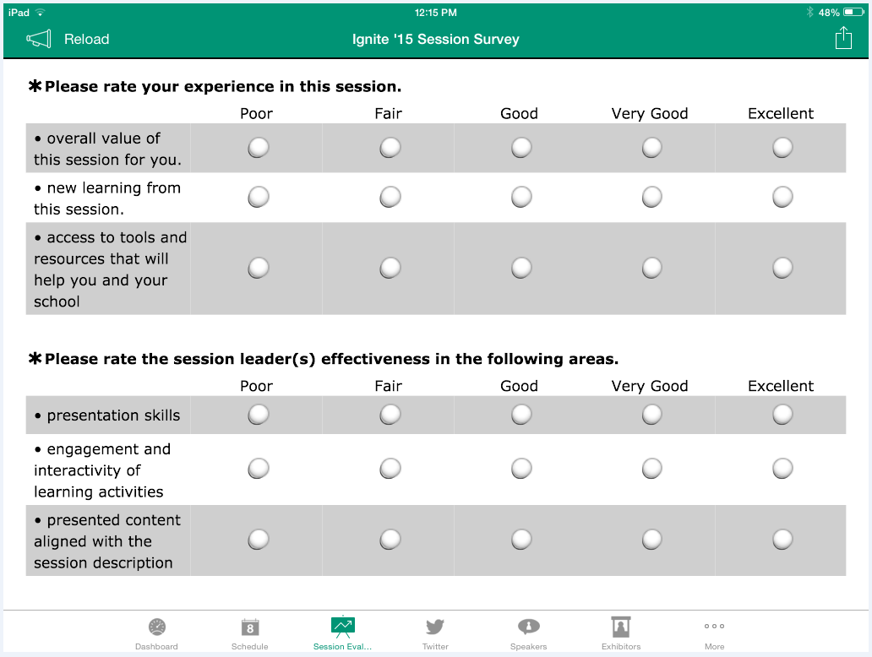
SESSION FEEDBACK FORM IN THE APP

Slide 36
SAVE
The DATE
2020 NASSP
National
Principals Conference
July 7-9, 2020
National Harbor, MD

Slide 37
??

